Slide 1
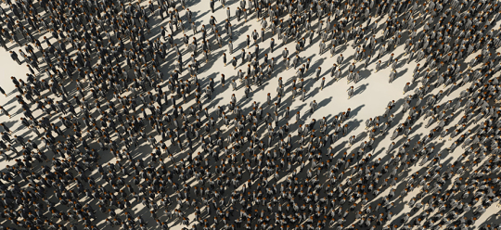
Inequality by Demographic Factors
Findings from Individual-Level Cantonal Tax Data
The Evolution of Economic and Social Inequalities in Switzerland (and Beyond): International Conference, Switzerland
Oliver Hümbelin und Rudolf Farys

Slide 2
Introduction
Income inequality is often understood as a result of unequal wages which are moderated through redistribution. But how is income inequality related to demographic factors or demographic change?
Current Demographic Development in Europe: Older, more numerous and diverse (Demography report 2010)
In Switzerland the picture is similar:
In the last 30 year Population grew by 1.8 Mio (Source: STATPOP)
A central part of the growth is due to Migration (average annual net migration since the 1980 is +28’000 Source: PETRA/STATPOP)
Swiss Population is ageing (Share of 65+: 1980: 14%, 2012: 17%, estimated in 2030: 24% Source: ESPOP, STATPOP, SCENARIO)
Household types are changing (Share of one-Person-HH 1980: 12%, 2012: 36%)
Notes:
Bevölkerung nach Alter
http://www.bfs.admin.ch/bfs/portal/de/index/themen/01/02/blank/key/alter/gesamt.html
Migration und Integration
http://www.bfs.admin.ch/bfs/portal/de/index/themen/01/07/blank/data/01.html
Haushaltsstrukturen und Familienformen
http://www.bfs.admin.ch/bfs/portal/de/index/themen/01/04/blank/01/02/01.html

Slide 3
Theories and «claims»
Demographic change and Inequality – Why does demography matter?
Ageing of a society and age groups
Ageing of the population leads to a conflict between generations (Kaufmann 2005), because the financial feasibility of social security is being tested. (see also Budowski & Nollert, M. (2010) > between group differences
Schellenbauer (2013): «In a world where wages depend only on the age of the workforce and are otherwise completely evenly, annual cross-section results leads to substantial inequality due to the age differences within society » > between group differences affects overall inequality
Notes:
Schellenbauer-These: Ungleichheit ist stark durch Alter determiniert
> Senoritätsprinzip: Arbeitserfahrung nimmt zu im Verlaufe der Zeit, Mincer?

Slide 4
Theories and «claims»
Demographic change and Inequality – Why does demography matter?
Change of household structure and household types
In Social policy research between household differences are of interest (e.g. Fritschi & Bannwart 2013 for redistribution with family allowances) > between group differences
Change in the «way of people living together» affects inequality (people marry later, and divorce more often). Daly and Valetta (2006) think that part of the rise in inequality in the US is due to the rise of people living alone (or single parents). (See Peichl et al. 2011 for Germany) > between group differences affect overall inequality
Notes:
Weiterer Punkt: Between group differences are particularly interessting for Familienpolitischen Verteilungsfragen. Unterschiede zwischen verschiedenen Haushaltsformen> Unterschiede zwischen Haushalten mit und ohne Kinder. Aber auch bezüglich allgemeinen Verteilung von Ressourcen. Welche Haushaltsformen leben in prekären Verhältnissen?
Empirische Evidenz?

Slide 5
Theory and Research Question
Demographic change and Inequality – Why does demography matter?
When linking demography to inequality two inequality-relevant «processes» must be separated;
(1) Demographic change can affect overall distribution
(2) Demographic change and especially segregation can lead to higher between group differences (which doesn’t necessarily affect overall distribution).
Research Question: Is overall inequality affected by demographic change? Do between group differences change over time, when looking at age groups and household types?
Notes:
(2) Die Mechanismen etwas erläutern. This would only be the case if within group differences would reduce. In the extreme case, we have very homogenous groups but high group differences

Slide 6
Data
Statistical «case studies» with individual cantonal Tax Data
Individual cantonal Tax Data which are collected as part of the SNF-Project (http://inequalities.ch/)
Tax data is administrative data, which means it’s a process generated, non-reactive data source (Diekman 2009:653)
Nice, because data coverage is good (no sample bias)
Bad, because data doesn’t always meet theoretical interesting constructs.
Data from six Cantons (ZH, BS, JU, AG, OW, BE). More to come…
Basel-City
Urban canton
German speaking
Time period: 1991-2011
Notes:
Regionalporträts der Kantone
http://www.bfs.admin.ch/bfs/portal/de/index/regionen/kantone/bs/key.html
Bei der Auswahl der Kantone haben wir zum Ziel möglichst lange Entwicklungsperioden abzudecken.

Slide 7
Variables
Net income, Household types and age groups
Net income (Reineinkommen)
Taxable measure that includes
+ Income from labor
+ Income from property
+ Direct social transfers
- Deductions, but no social deductions
Household structure
Married without kids
Married with kids
Single mom
Single dad
Single man
Single woman
Age groups
-25: young adults (education is important)
26 – 65: working population (wages)
65>: Retired (pensions)
Notes:
Einkommen > Es ist nicht in jedem Fall ein Haushaltseinkommen, es hat Abzüge (können als obligatorische Ausgaben aufgefasst werden)> dann landet man beim verfügbaren Einkommen
Household typs > we have household concering tax dossiers not real households (cohabitation without legal marriage is not properly covered)
Age we have age of tax dossier leader (for married people we have the age of the person, who contributes most to the household

Slide 8

Method
Decomposing Overall inequality into within and between group components (Hao & Naiman 2010)
Theil-Index, an inequality measure developed from information theory, is additively decomposable (Gini is not). Theil can be expressed as the between-group inequality plus the weighted sum of the inequality within each group
$I(y;θ\text{)}=\sum_{l=1}^{L}{∅^{l}{\left(\frac{μ^{l}}{μ}\right)}^{θ}I\left(y^{l};θ\right)+I(μ^{1},…,μ^{l},…μ^{L};}θ$)
By decomposing the Theil-Index we partitioned the total income inequality into between-group inequality (e.g. between age groups and household types) and within-group inequality. Hence we see, how the differences between and within each group contribute to overall inequality
within
between
Notes:
Remarks - you get between group inequality by assigning the group mean to every group member and the calculate the inequaltiy meassure
- The within group inequality indices are weighted with the adjusted group proportion > with large groups the weights seem to sum to 1. Adjustment is important for small sample size

Slide 9
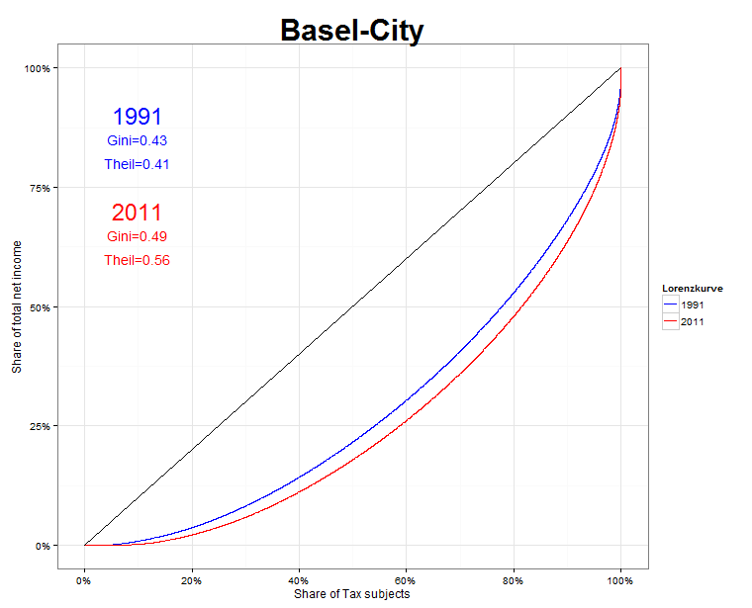
Results
Overall Inequality and demographic change
Notes:
(1) No big changes concerning shares of age groups
(2) Inequality did rise
(3) Within group inequality «drives» overall inequality…
…but importance of between group differences grew.

Slide 10
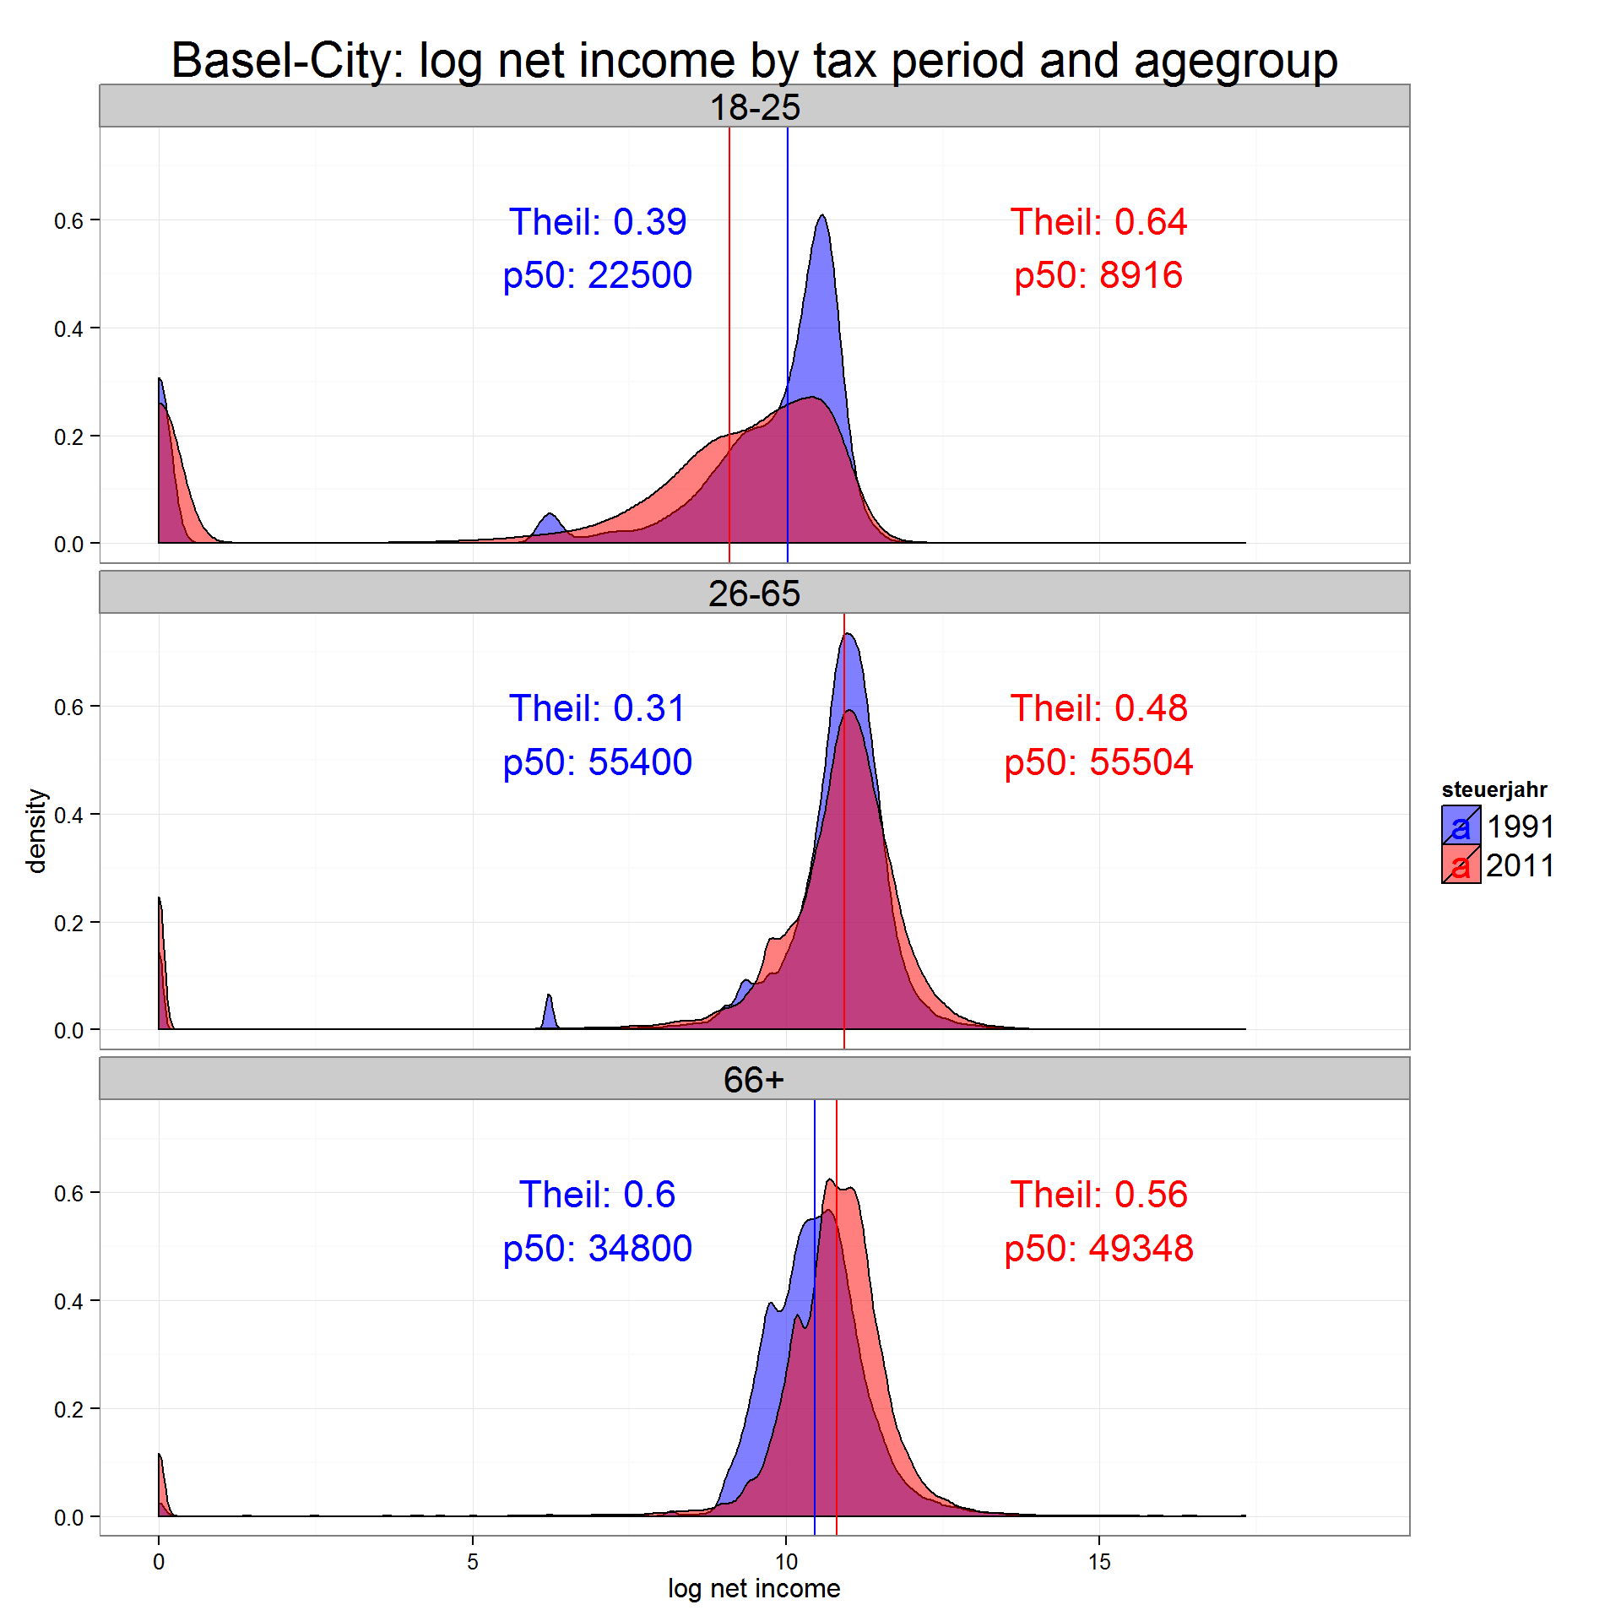
Results
Age groups - Between and within group inequality
Overall within Inequality is bigger than between inequality
1991: W=0.38, B=0.03
2011: W=0.51, B=0.05
On average young adults lost, while retired gained and workforce were “stable”
But: Inequality within workforce and especially among young adults increased strong
Notes:
Junge Erwachsene sind heute länger in Ausbildung > verdienen weniger, Einkommen sind heterogener
- Vergleiche über die Zeit und zwischen den Gruppen

Slide 11
Results
Age groups - Contribution of each within inequality component and between inequality to overall inequality
Inequality among Workforce (26-65) contributes most to overall inequality (big group) and relevance of inequality within this age group is rising.
Small increase of between-group component is because young adults “lost” relatively

Slide 12
Results
Households - Demographic change and contribution of within and between inequality to overall inequality
Global trend is reflected in cantonal data: decline of married and rise of single households
Between group differences contribute with a relevant share to overall inequality
Notes:
Muss man sich noch überlegen, wie das genau dargestellt werden soll
Contribution to overall Inequality rausnehmen
Der Überschuss bei den Single Women lässt sich vor allem durch Witwen erklären > Männer sterben früher als Frauen.

Slide 13
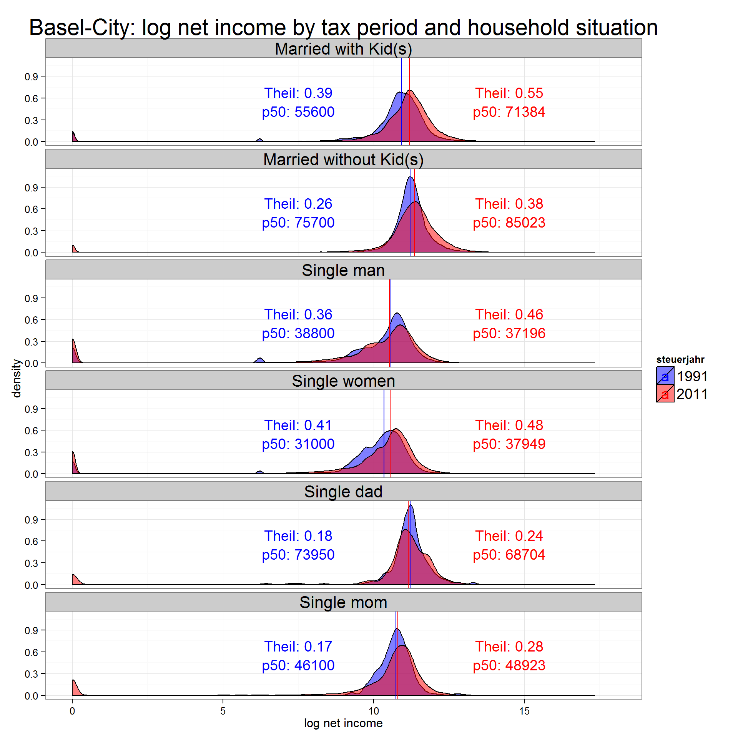
Results
Households- Between and within inequality
Between group differences are high between married and single
married HH gained more on average (pronunciation of between group differences)
But: Inequality reaches a maximum at a single-share of about 60%
Notes:
Grafiken unter dem Aspekt von Lebenszyklus und Haushaltsbildung besprechen:
married without kids bspw. > junge Paare und Personen im späten Erwerbsalter (Kinder bereits ausgezogen).

Slide 14
Results
Households- Contribution of each within inequality component and between inequality to overall inequality
Contribution to overall inequality is especially high due to inequality among married w. kids and within singles
Between group differences contribute also to overall inequality
Notes:
Muss man sich

Slide 15
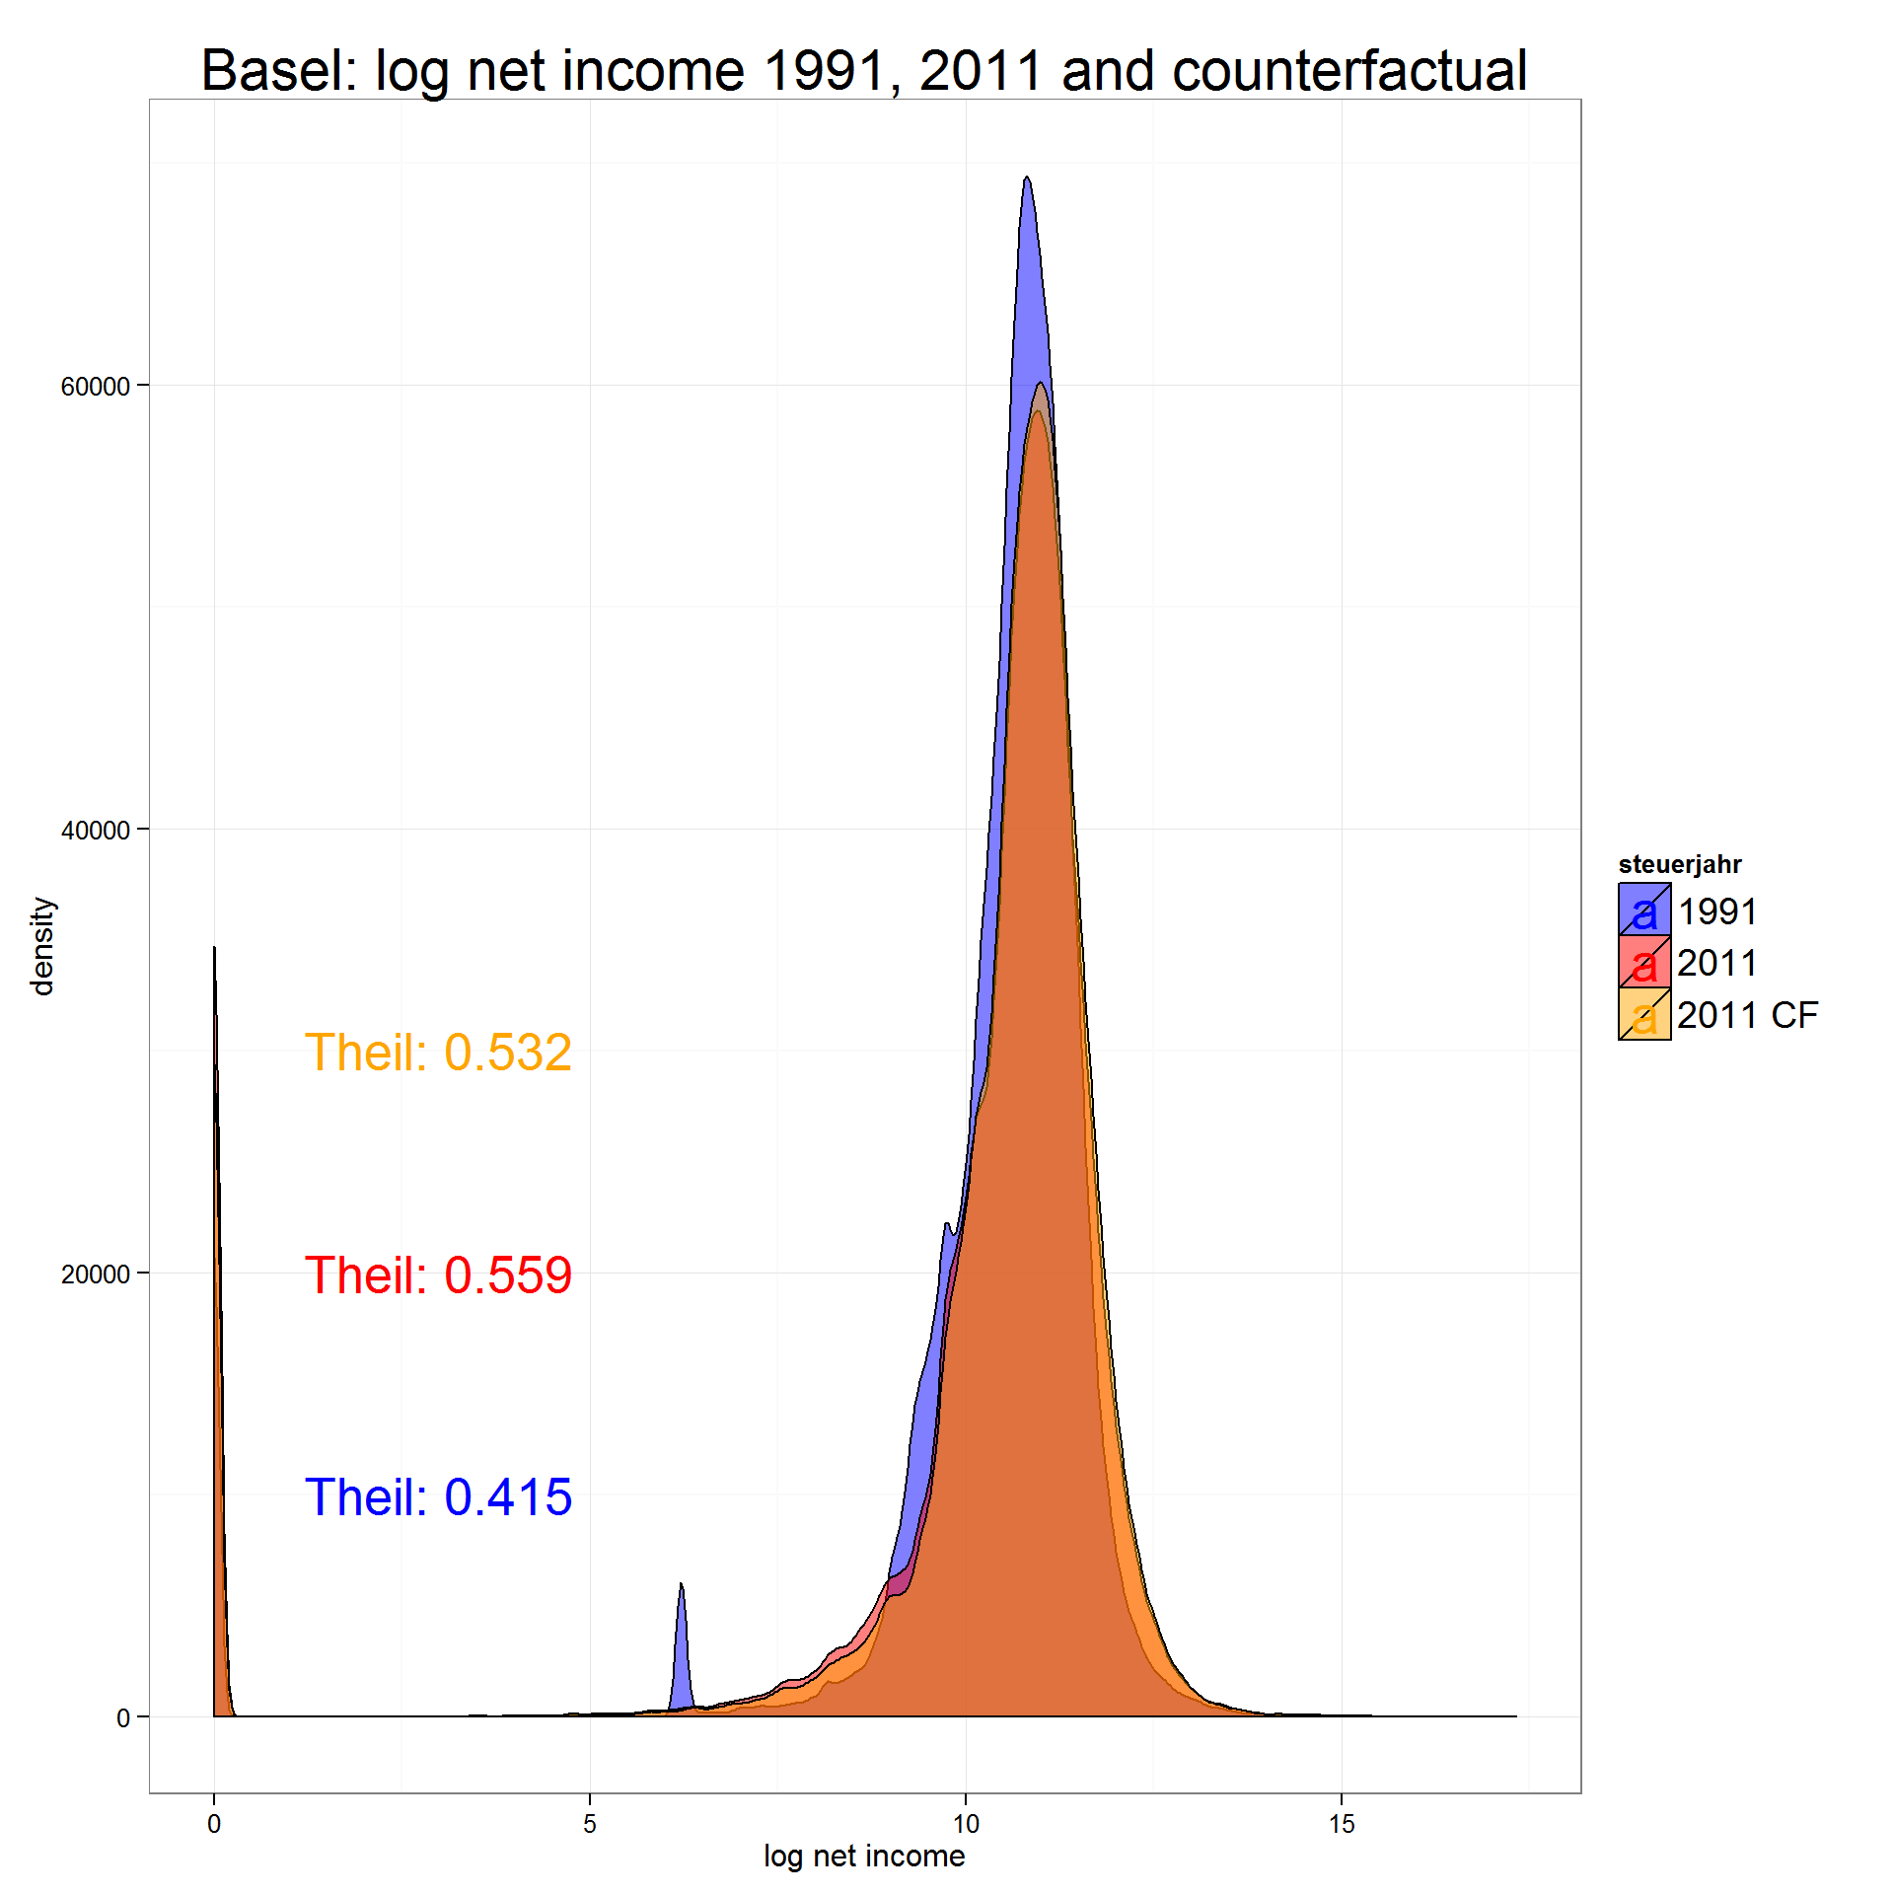
Counterfactual Distribution – How would inequality look like, if demographic structure wouldn't have changed?
Method
Weighting of 2011 distribution with 1991 weights calculated with inverse probability weighting
Result
Inequality would be smaller
19% of rise of inequality is due to change in demographic variables (age, household)
Notes:
15

Slide 16
Conclusion
Ageing of the population leads to a conflict between generations (Kaufmann 2005)
→ Indeed, inequality rose for working people and decreased for retired while
median incomes rose for retired people only
→ Overall inequality is strongly affected (61%) by inequality within workforce (25-65). Trend is rising.
→ Ageing of society is rather associated with more equality
Rise in inequality in the US due to more people living alone (Daly/Valetta (2006)
→ People indeed live less and less in married households
→ Contribution of within single inequality and importance of between component to overall inequality did rise
→ More inequality with more single households?
→ does a „single“ equal a single household? Further analyses with Bern data
Notes:
16

